Slide 1
PRE-ETUDE - Path planning and combat maneuvers for target Drones
07/10/2020
Hussein HAMADI

Slide 2
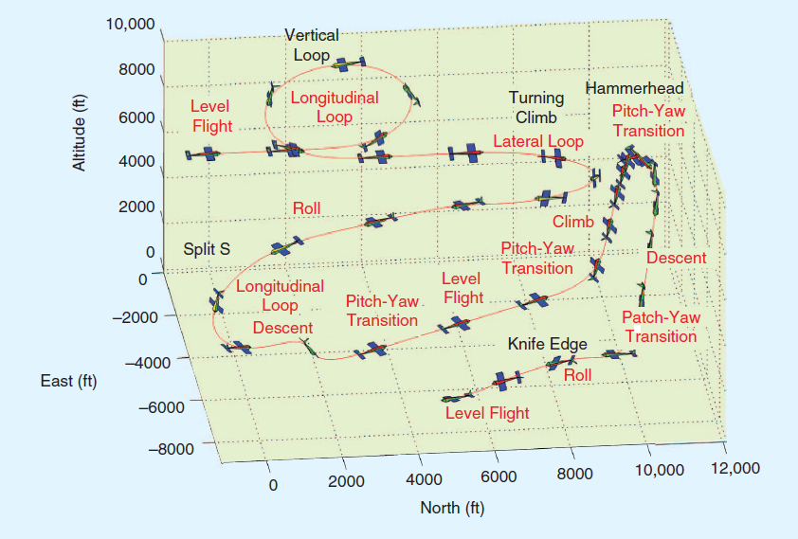
Path and attitude history of an aerobatic sequence

Slide 3
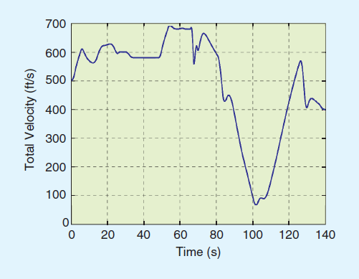
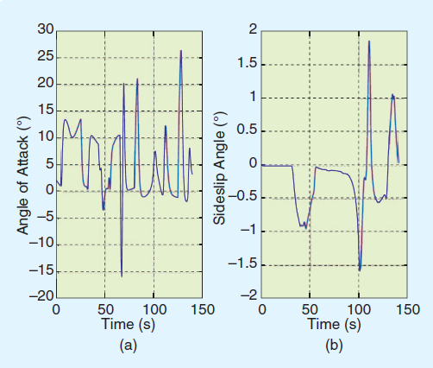
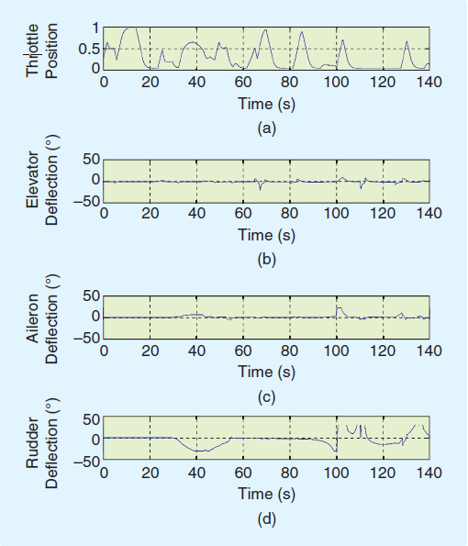
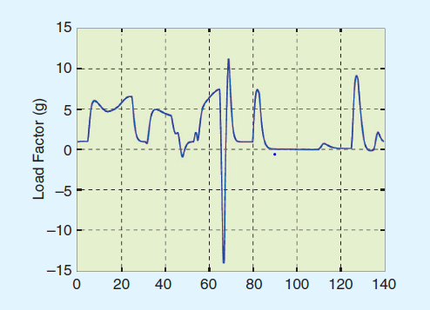
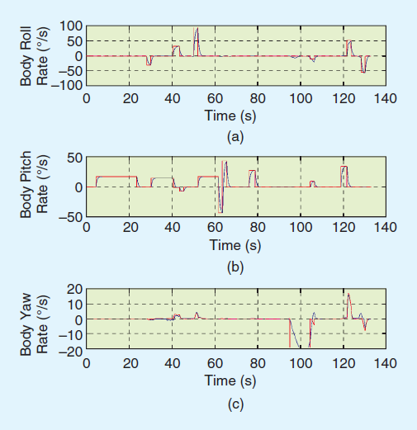
Path and attitude history of an aerobatic sequence

Slide 4
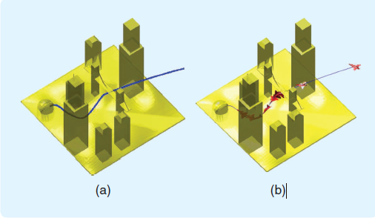
Path Planning & Maneuver Planning
Output of Path Planner
Output of Maneuver Planner

Slide 5
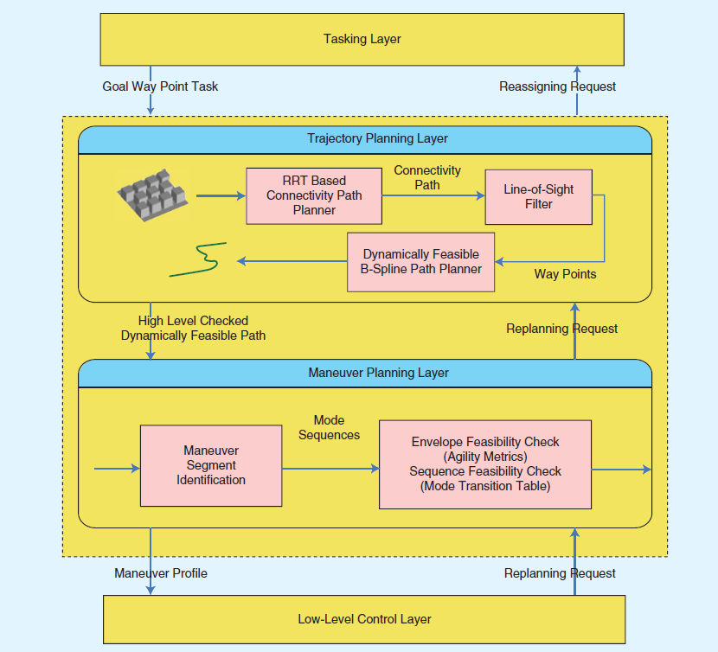
Path and Maneuver Architecture

Slide 6
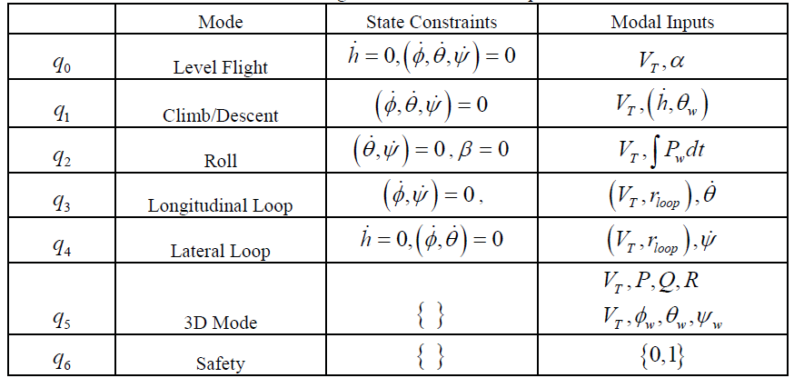
Modal Inputs for Maneuvers

Slide 7
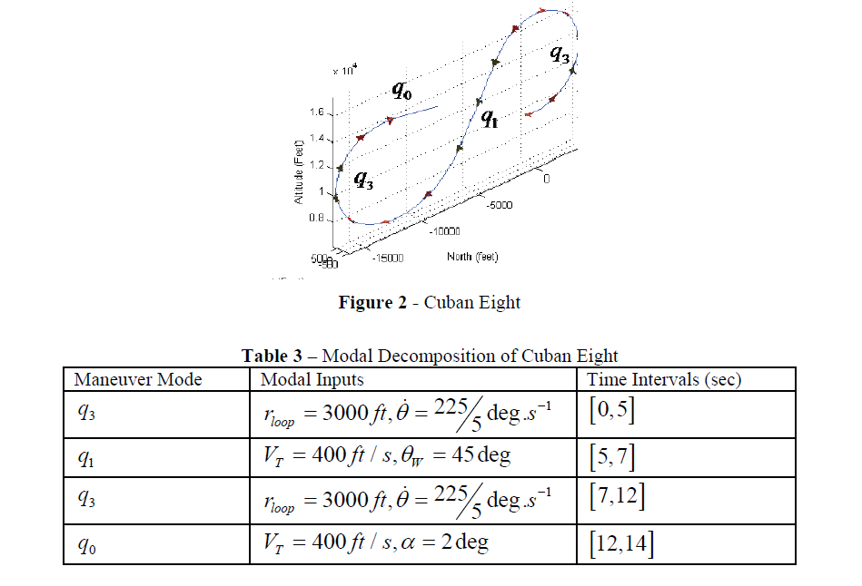
Modal Decomposition of path planner output

Slide 8
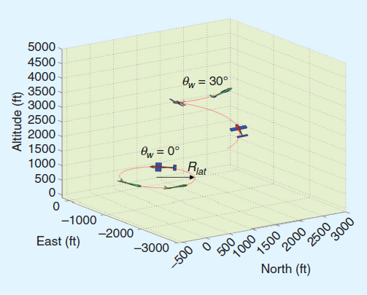
Difference btw aerobatics and air combat Maneuvers
Lateral loops with zero and nonzero wind axes pitch angles.
Zero pitch angle refers to a coordinated turn, with zero altitude change.
Nonzero pitch angles result in coordinated climbing-turning maneuvers, which are commonly encountered in air combat.

Slide 9
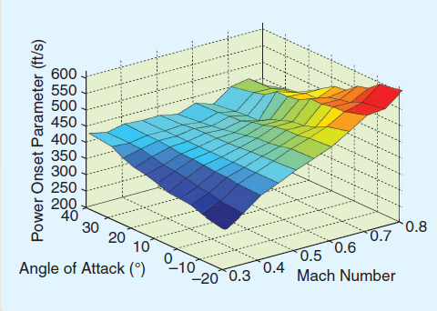
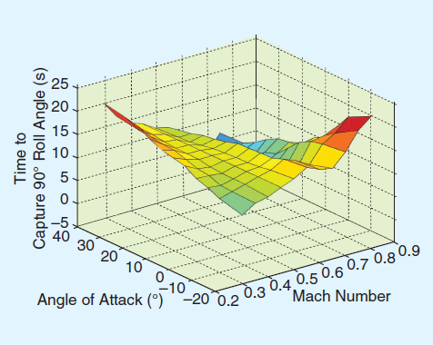
Agility Metrics – aeronautical performance metrics
Power onset/loss parameter. This metric represents the agility in level-flight mode and provides a preferable region for selecting the velocity
Time to capture 90° of roll angle. This metric represents the agility in roll mode and provides a preferable region for selecting the modal input and angle of attack for roll dynamics.

